Slide 1
Monte Carlo Simulation for
Delivery Service
Yekai Chen
Yue Xian
Xiner Liu
Notes:
Xia

Slide 2

01
Background
02
Uncertainty
The location of delivery destination
03
Simulation
Traffic condition on roads
Scenario 1： Wait or Not
Food preparation time
Scenario 2：
Number of delivery men
04
Summary and Future Work
IS 590 Program Analytics & Data Process
Final Project Presentation
Yekai Chen
Yue Xian
Xiner Liu
Notes:
Xia

Slide 3

Background
Notes:
Wentao

Slide 4

01
Background
IS 590 Program Analytics & Data Process
Final Project Presentation
Yekai Chen
Yue Xian
Xiner Liu
Notes:
Wentao

Slide 5
Uncertainty
Notes:
Wentao

Slide 6
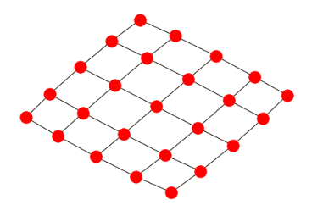
02
The location of delivery destination
Restaurant
IS 590 Program Analytics & Data Process
Final Project Presentation
Yekai Chen
Yue Xian
Xiner Liu

Slide 7
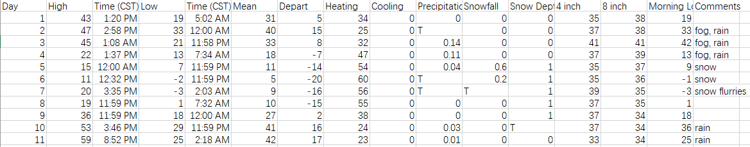
02
Travel Time
Traffic Condition
Weather Condition
IS 590 Program Analytics & Data Process
Final Project Presentation
Yekai Chen
Yue Xian
Xiner Liu
Notes:
Wentao

Slide 8

02
Food preparation time
IS 590 Program Analytics & Data Process
Final Project Presentation
Yekai Chen
Yue Xian
Xiner Liu
Notes:
Wentao

Slide 9
Simulation

Slide 10
03.1
Simulation#1-Wait or Not
One order is ready to be delivered and a new order just come in.
In what condition of the locations of customers and the number of orders in line we should wait and deliver these two together or deliver it right now and then come back for the other?
IS 590 Program Analytics & Data Process
Final Project Presentation
Yekai Chen
Yue Xian
Xiner Liu

Slide 11
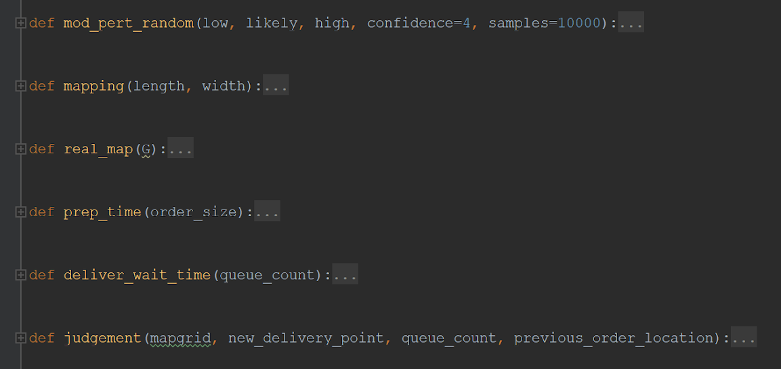
03
Simulation#1-Wait or Not
03.1
Used for estimate the travel time for each road
Generate a grid to represent the neighborhood of restaurant. And generate the PERT parameters for each edge. Restaurant location
Use generated 3 PERT parameter of each road to estimate the travel time
Estimate the order preparation time based on random order size
Compare the total time cost of two options to make decision on wait or not
IS 590 Program Analytics & Data Process
Final Project Presentation
Yekai Chen
Yue Xian
Xiner Liu

Slide 12
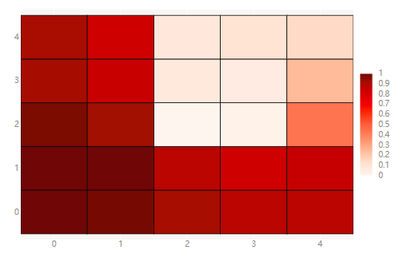
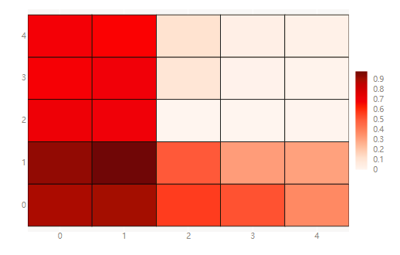
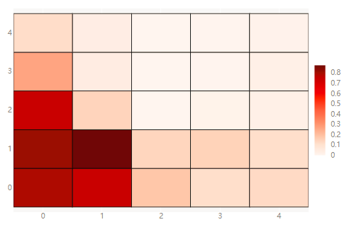
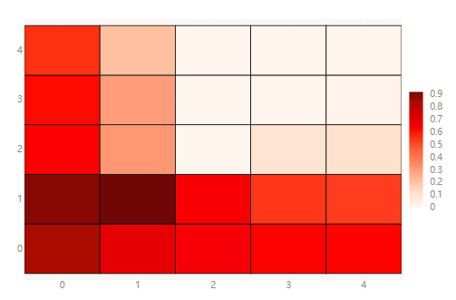
03
Simulation#1-Wait or Not
03.1
Previous Order Destination: (1, 1)
Repeat 1000 times
Heatmap on the percentage of decision to wait
order = 0
order = 1
order = 2
IS 590 Program Analytics & Data Process
Final Project Presentation
Yekai Chen
Yue Xian
Xiner Liu
Notes:
Percentage to wait

Slide 13
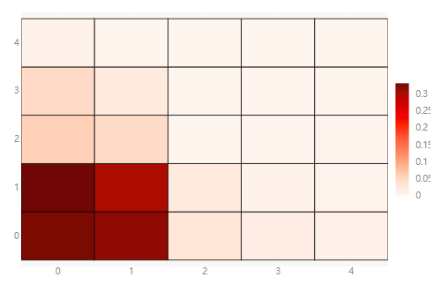
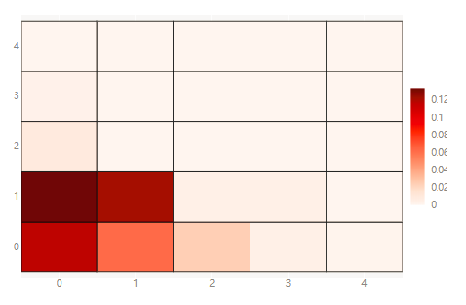
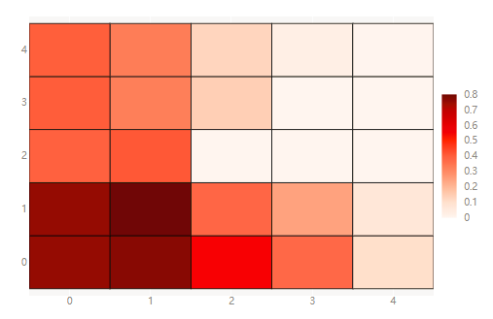
03
Simulation#1-Wait or Not
03.1
Previous Order Destination: (1, 1)
Repeat 1000 times
Heatmap on the percentage of decision to wait
order = 3
order = 4
order = 5
IS 590 Program Analytics & Data Process
Final Project Presentation
Yekai Chen
Yue Xian
Xiner Liu
Notes:
Percentage to wait

Slide 14
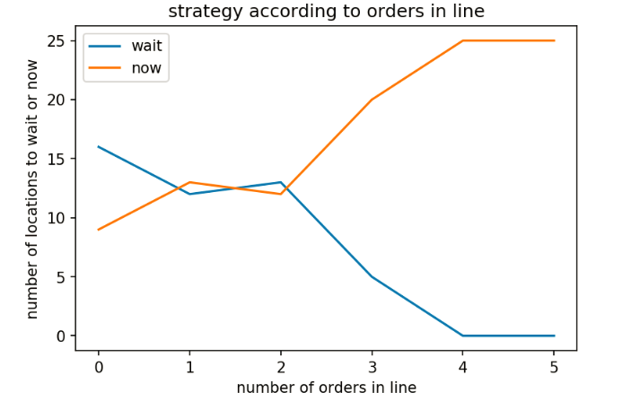
03
Simulation#1-Wait or Not
03.1
IS 590 Program Analytics & Data Process
Final Project Presentation
Yekai Chen
Yue Xian
Xiner Liu

Slide 15
03
Simulation#2-Number of delivery men
03.2
Every day, the restaurant is trying to complete certain amount of orders
Number of delivery men will influence the delivery time.
if delivery time > 30min, customer will cancel the order, thus there will be no revenue from the order
Profit = Total revenue - Material cost - Delivery men daily salary
IS 590 Program Analytics & Data Process
Final Project Presentation
Yekai Chen
Yue Xian
Xiner Liu

Slide 16
Summary and Future Work

Slide 17

04
Summary and Future Work
Code Optimization
Complete Scenario 2
More ways to show result
IS 590 Program Analytics & Data Process
Final Project Presentation
Yekai Chen
Yue Xian
Xiner Liu

Slide 18
Summary and Future Work
1. Weather Data: https://www.isws.illinois.edu/statecli/urbana/urbana-monthly-2017.htm
2. NetworkX: https://networkx.github.io/documentation/stable/tutorial.html
3. BQPlot: https://bqplot.readthedocs.io/en/latest/
IS 590 Program Analytics & Data Process
Final Project Presentation
Yekai Chen
Yue Xian
Xiner Liu

Slide 19
Thank You
IS 590 Program Analytics & Data Process
Final Project Presentation
Yekai Chen
Yue Xian
Xiner Liu

